Slide 1

Chapter 3
The Relational Data Model

Slide 2

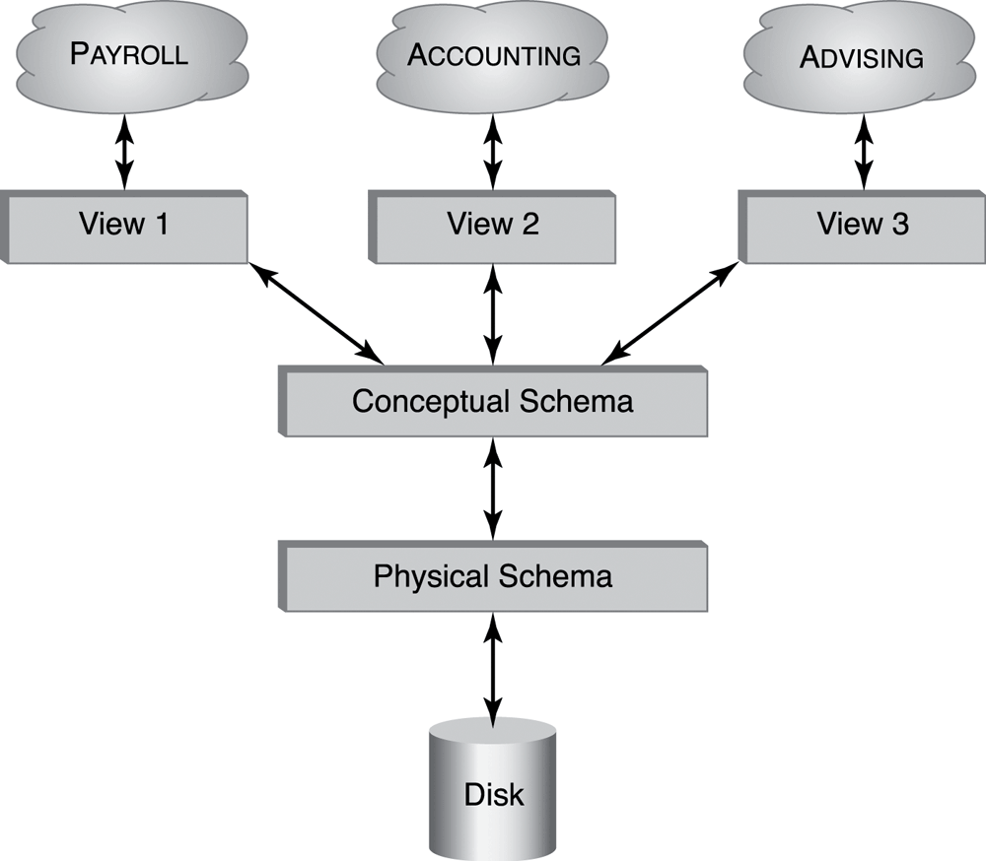
Figure 3.1 Levels of data independence.
Notes:
2
2
The interest rate that prevails in the bond market is determined by the demand for and supply of bonds.

Slide 3
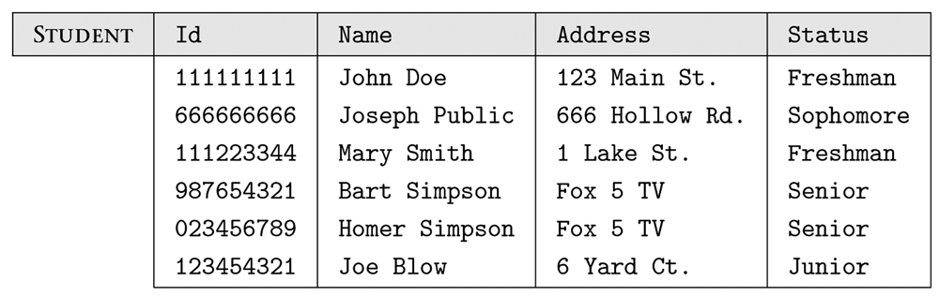
Figure 3.2 Instance of the STUDENT relation.

Slide 4
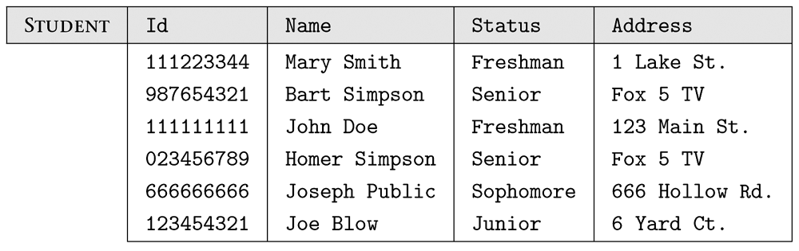
Figure 3.3 STUDENT relation with different order of columns and tuples.

Slide 5
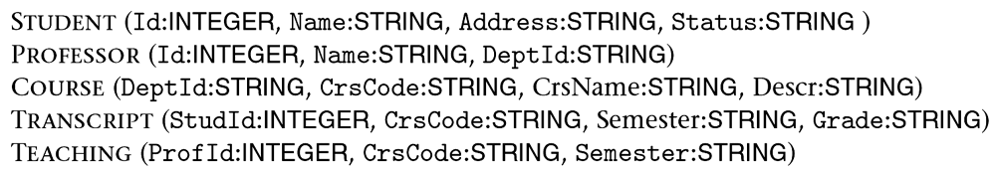
Figure 3.4 Fragment of the Student Registration database schema.

Slide 6
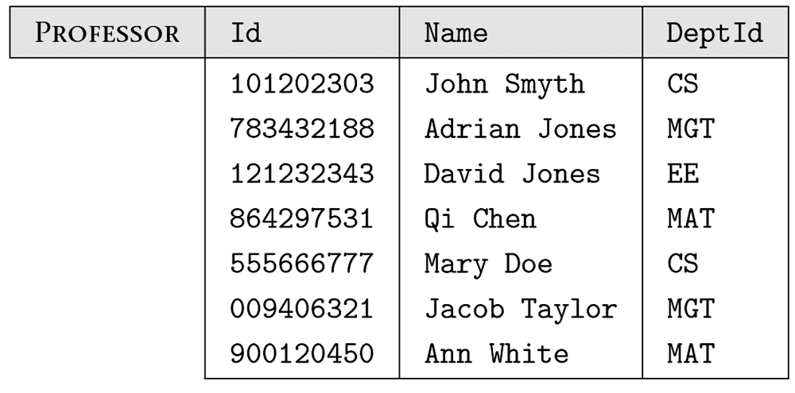
Figure 3.5 Examples of database instances.

Slide 7
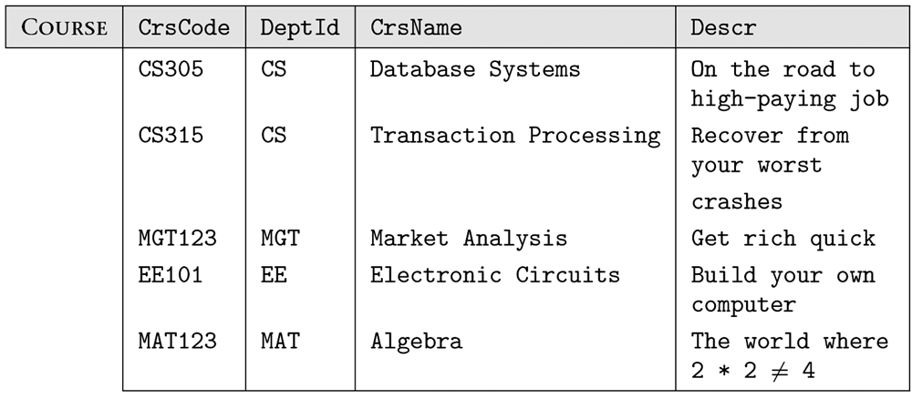
Figure 3.5 Examples of database instances. (cont’d)

Slide 8
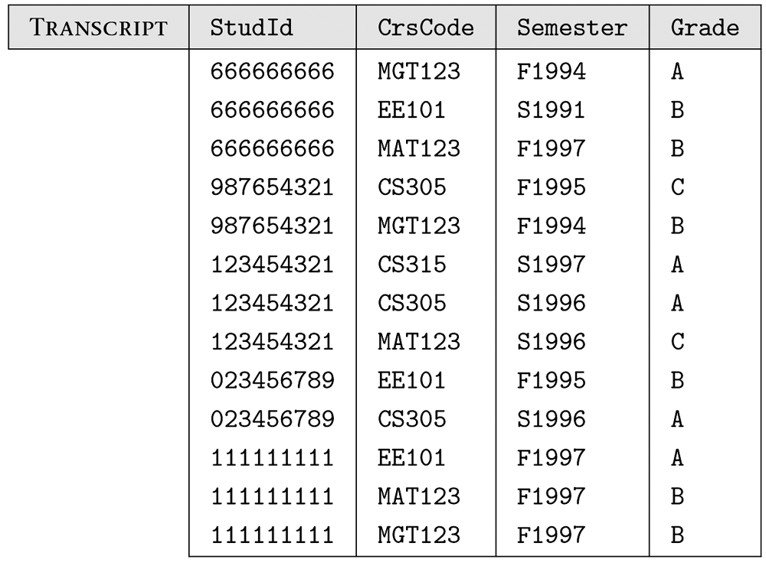
Figure 3.5 Examples of database instances. (cont’d)

Slide 9
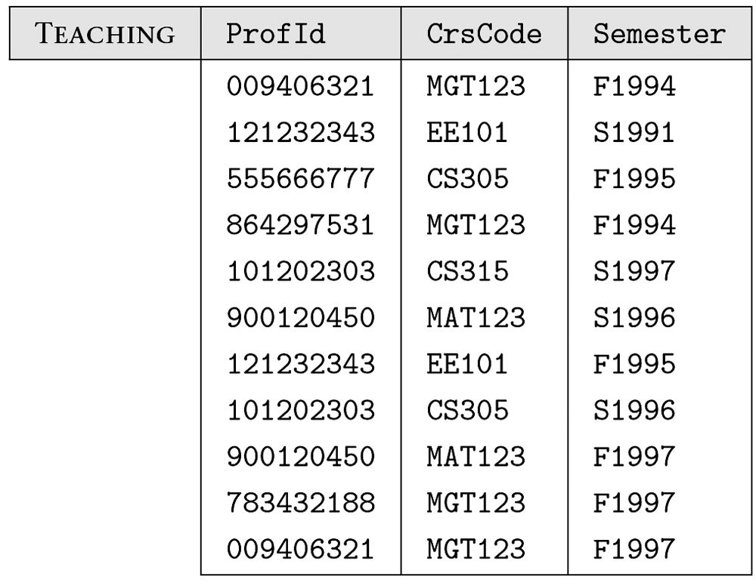
Figure 3.5 Examples of database instances. (cont’d)

Slide 10
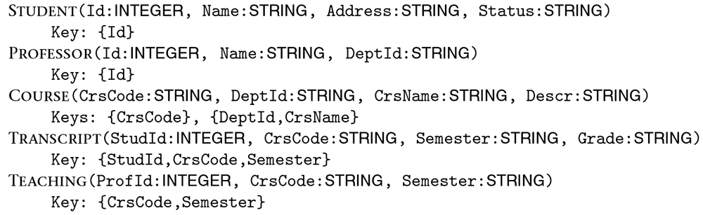
Figure 3.6 Fragment of the Student Registration database with key constraints.

Slide 11
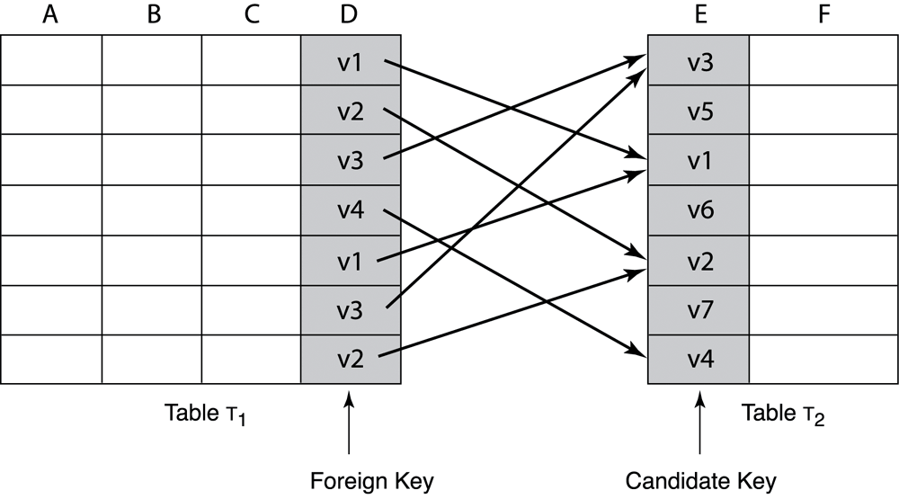
Figure 3.7 Attribute D in Table T₁ is a foreign key that refers to the candidate key, attribute E, in Table T₂.

Slide 12
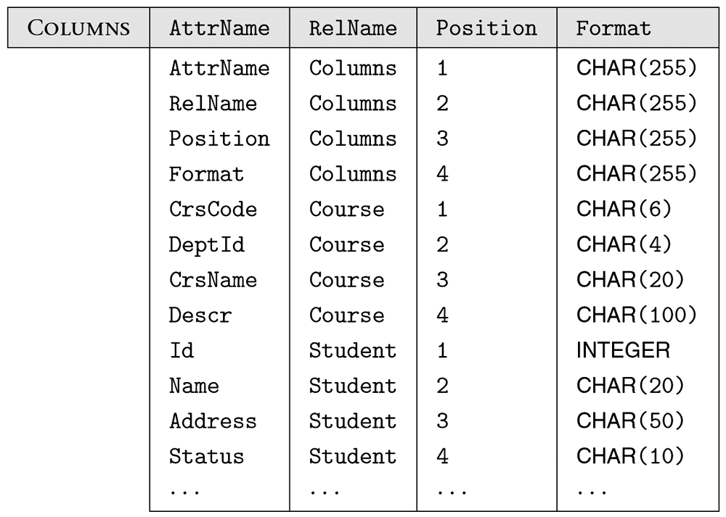
Figure 3.8 Catalog realtion.

Slide 13
Figure 3.9 Contents of the view defined by SQL statement (3.5).

